Slide 1
Project Presentation of CO-OP Project at Industry (Module-2) (22CS421)
On
Privacy Preserving Edge AI Based Attention and Emotion Tracking System for Hybrid Classrooms
Submitted By:
Amol Sharma 2210991254
Aman 2210991243
Ashish 2210991399
Ronit 2210992186
Supervised by:
Dr. Gifty Gupta
Department of Computer Science and Engineering,
Chitkara University, Punjab

Slide 2
Project Statement:
This presentation outlines our experience as an Integrated Project, where we developed an AI-enhanced engagement tracker for young learners. We will delve into the project's core elements, including the utilization of AI and deep learning models, image processing techniques, real-time feedback mechanisms, and the tools and libraries employed to enhance focus detection and interaction monitoring in educational settings.

Slide 3
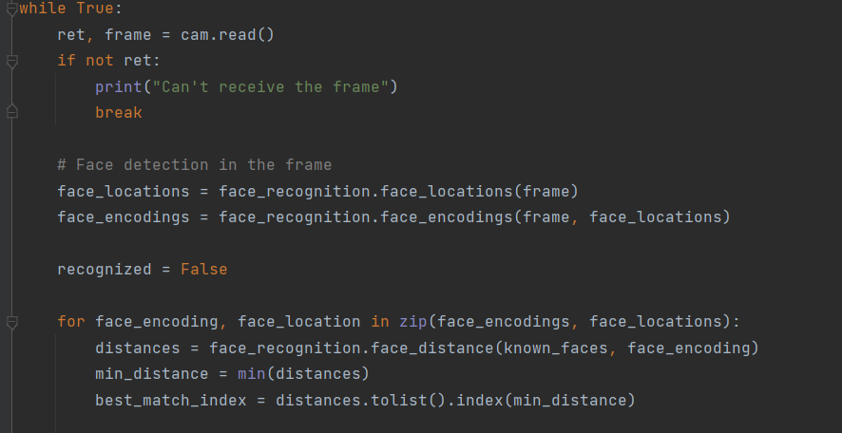
This presentation outlines our experience as an Integrated Project, where we developed an AI-enhanced engagement tracker for young learners. We will delve into the project's core elements, including the utilization of AI and deep learning models, image processing techniques, and the tools and libraries employed.

Slide 4
Types of AI and Deep Learning:
Types of AI
Narrow AI (Weak AI):
Designed for specific tasks (e.g., voice assistants, recommendation systems).
General AI (Strong AI):
Mimics human intelligence, capable of learning and problem-solving across diverse domains.
Super AI:
A theoretical concept where AI surpasses human intelligence in all aspects (still in development).

Slide 5
Deep Learning
Definition:
A subset of machine learning that uses neural networks to simulate the way humans learn, enabling AI to process and analyze large, unstructured datasets.
Key Features:
Multilayered neural networks for hierarchical learning.
Applications in image recognition, speech processing, and natural language understanding.
Example:
AI-powered image recognition systems that identify objects, emotions, or even classroom engagement levels.

Slide 6
Discussion & Milestones Achieved
Overview:
Leveraging advanced face recognition and video processing technologies to monitor and enhance classroom engagement effectively.
Technical Milestones:
Real-Time Face Detection:
Instantly identifies faces within the classroom.
Student Identification:
Verifies registered students; flags unregistered individuals.
Multiple Face Tracking:
Seamlessly tracks multiple students simultaneously.

Slide 7
Advanced Monitoring:
Incorporates eye movement analysis and motion detection for deeper engagement insights.
Data Management:
Captures snapshots and stores attendance data in screenshots and Excel sheets for easy analysis and reporting.
These milestones reflect significant progress in developing a system that ensures precision, scalability, and actionable insights for educators.

Slide 8
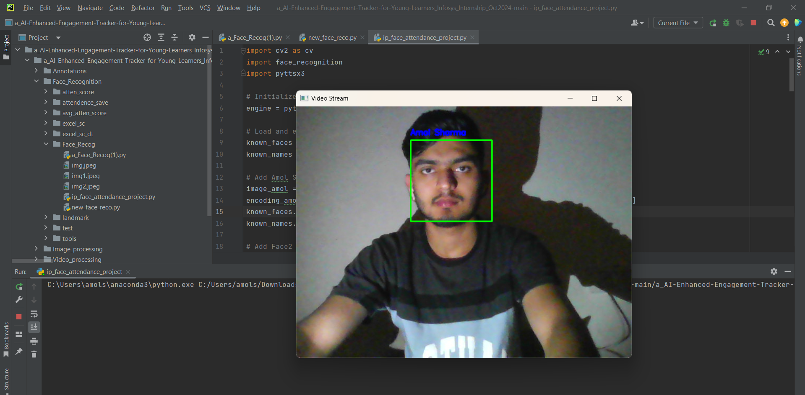
Screenshot :

Slide 9
Key Learnings and Future Scope
1
AI Applications
This Project deepened our understanding of AI's role in education.
Image Processing Techniques
2
We gained hands-on experience with image processing techniques in a real-world setting.
3
Team Collaboration
We learned the importance of teamwork and communication within a collaborative project.

Slide 10
Prerequisites (in terms of knowledge, concepts and material) for doing the Project:
Basic knowledge of Python and its libraries.
Familiarity with OpenCV, TensorFlow
Knowledge of Artificial Intelligence
Experience with Amazon S3 for efficient and secure data storage.
Experience with face recognition methods.

Slide 11
Material that may be required to make the project and where it might be available
Laptops/computers with internet access
Software tools: PyCharm, Excel (available online for free)

Slide 12
Conclusion:
This Project provided an incredible opportunity to apply our knowledge of AI and image processing to create a solution that can potentially enhance the learning experience for young learners. The future scope of this project includes expanding its capabilities by incorporating more sophisticated AI models, exploring new image processing techniques, and integrating it with various educational platforms.

Slide 13
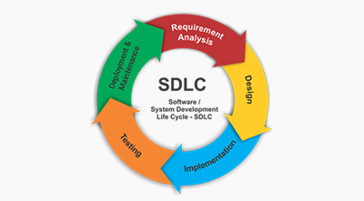

Slide 14
Thank You
14

